Slide 1

Machine Learning Applications: Google Flights Results
Rob Johns
Metis Data Science
July 2019

Slide 2

The airline industry is booming
US Bureau of Transportation:
Q1 2019 Net Profit (Domestic): $2.1 Billion
8.4 Million Domestic and 1.6 Million International flights in 2018
2.36 Million passengers already in top 5 traffic airports in 2019
Average cost of flight $344

Slide 3

Can Machine Learning help businesses and consumers save money on flights?

Slide 4
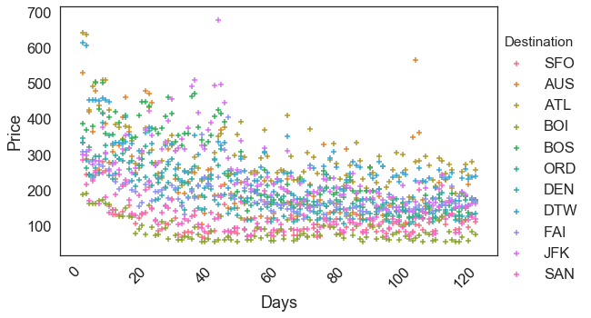
Automated data collection enables exploration of flight trends
120 days starting 7/22/2019
15,878 Flights
1-way
Domestic
Non-stop
Includes carry-ons

Slide 5
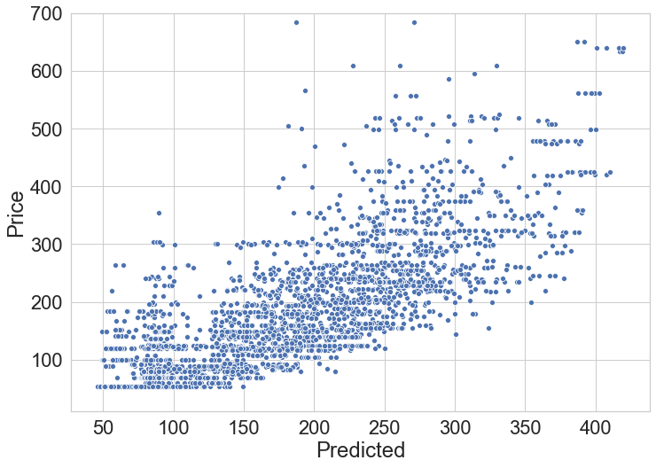
Linear regression yields predictions of prices
Impactful factors:
Route
Time of year
Time in advance
Linear regression returns an average error of ~$50

Slide 6
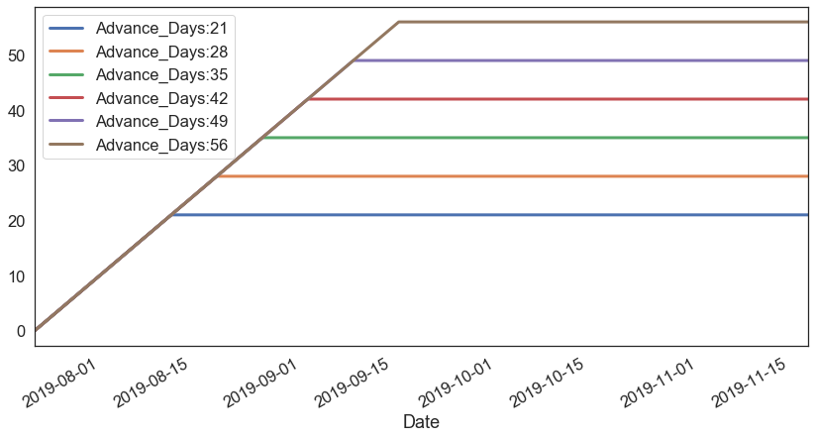
Feature engineering for predicting price plateaus
Introduction of step function parameters
A tradeoff between overall prediction quality and ability to extract general insight from ML model
Lasso fit constrains model to pick one of these features

Slide 7

Book
5 Weeks
in Advance

